Slide 1
Networking 2.0
Networking in the Information Age

Slide 2
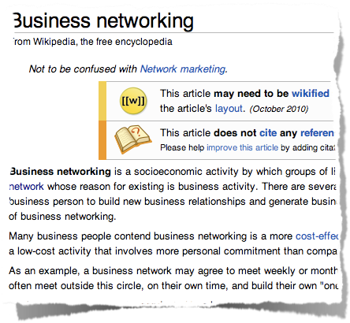
What is Networking?
http://en.wikipedia.org/wiki/Networking
Notes:
Distinction is made here between Social and Business, but lines are being blurred now
Sites like LinkedIn have social networking aspects and sites like Facebook have business networking aspects

Slide 3
net·work·ing
[net-wur-king]
–noun
1. a supportive system of sharing information and services among individuals and groups having a common interest:Working mothers in the community use networking to help themselves manage successfully.
2. the design, establishment, or utilization of a computer network.
–adjective
3. of or pertaining to a network or networking: networking software, a networking system.
http://dictionary.reference.com/browse/networking
Notes:
Supportive System
Common Interest
Next Slide: Networking 1.0

Slide 4
Networking 1.0
http://www.youtube.com/watch?v=7j1nHdURKgE
Notes:
Had to be in same physical location
Conferences, Conventions
Next Slide: The Internet

Slide 5
The Internet
http://www.youtube.com/watch?v=iDbyYGrswtg
Notes:
Internet really shook things up.
People becoming more and more connected to information and each other

Slide 6
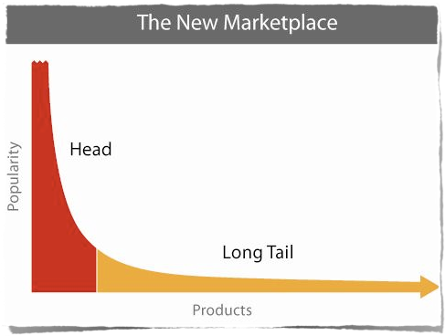
The Long Tail
http://www.hyperionbooks.com/book/the-long-tail-revised-and-updated-editionwhy-the-future-of-business-is-selling-less-of-more/
Notes:
Book discusses commerce but has social implication as well.
People with similar interests can now find others with same interests, no matter how obscure.

Slide 7
Sharing Common Interests
http://www.facebook.com/RedWormComposting
Notes:
With millions of people on the internet there is bound to be a group networking over pretty much any topic, no matter how obscure

Slide 8
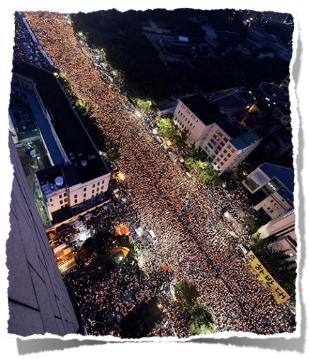
South Korean Protests 2008
http://en.wikipedia.org/wiki/2008_US_beef_protest_in_South_Korea
Notes:
Dong Bang Shin Ki - Rising Gods of the East (South Korean boy band)
Their discussion board was a place for the young “candlelight girls” to meet and talk about issues
President publicly apologized for not paying attention to what the people wanted.

Slide 9
Iranian “Twitter Revolution”
http://www.time.com/time/world/article/0,8599,1905125,00.html
Notes:
Summer 2009
Iranians used Twitter to share protest locations, pictures, video
People in other countries showed solidarity by changing avatar green
Allowed the world to connect to what was happening

Slide 10
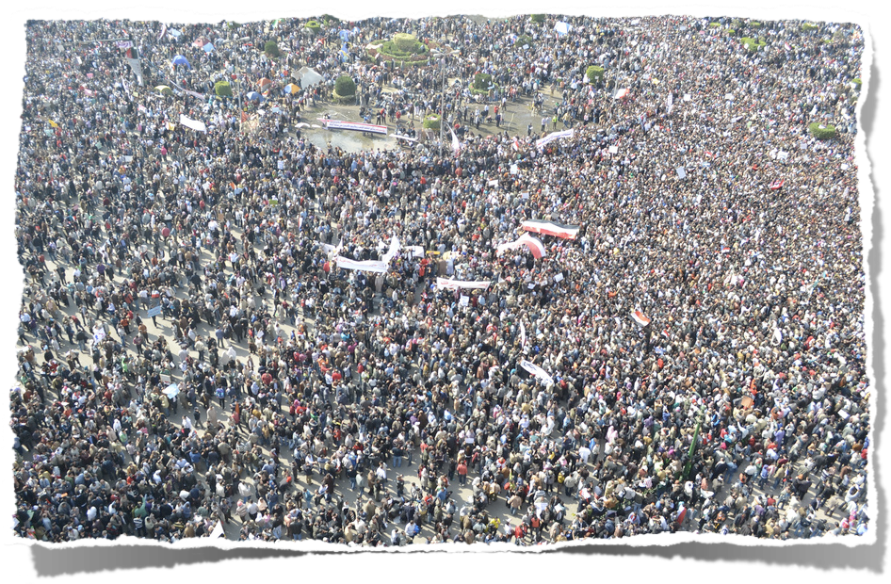
“We use Facebook to schedule the protests, Twitter to coordinate, and YouTube to tell the world,”
Cairo Protester on Twitter, http://www.miller-mccune.com/politics/the-cascading-effects-of-the-arab-spring-28575/
Notes:
Egypt
18 days
social networking didn’t cause, but allowed it to happen quickly

Slide 11
Twitter
http://twitter.com/
Notes:
#ehr
#emr
#hipaa
#icd10

Slide 12
wefollow
http://wefollow.com/
Notes:
healthinformation

Slide 13
Facebook
http://www.facebook.com/
Notes:
ahima

Slide 14
LinkedIn
http://www.linkedin.com/
Notes:
ehr

Slide 15
Building & Maintaining Your Network

Slide 16
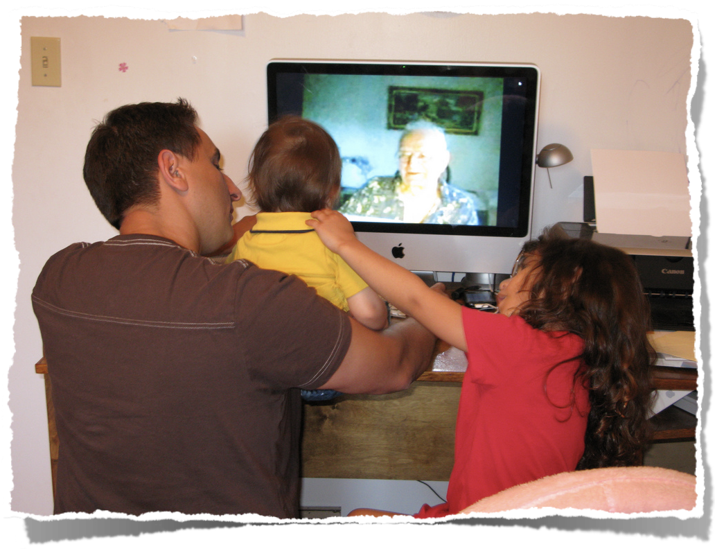
Connecting
Photo courtesy courosa (http://www.flickr.com/photos/courosa/2755743456/)
Notes:
Important to start with making connections
Start following a lot of people, you can always unfollow
The good resources will become quickly evident

Slide 17
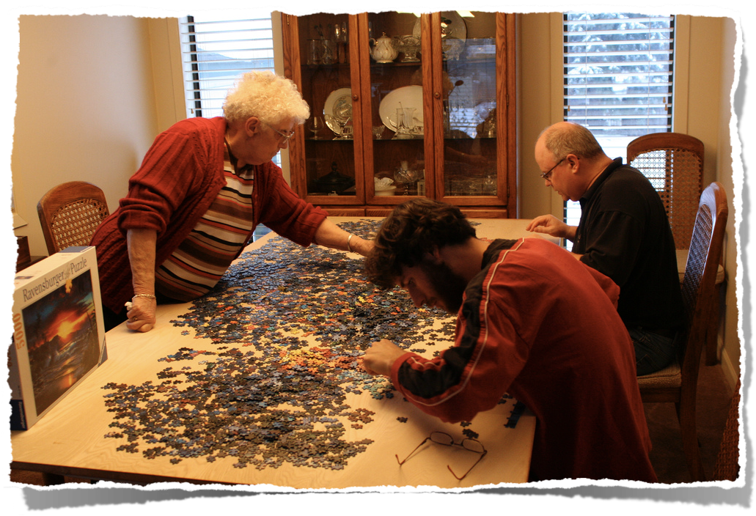
Participate and Contribute
Photo courtesy hadsie (http://www.flickr.com/photos/hadsie/2144134905/)
Notes:
Be an active participant
It takes work, but the payoff is worth it
Networks are like a stream, dip in every once in a while, don’t have to keep track of it all

Slide 18
Andy Duckworth
@aduckworth
aduckworth@tacomacc.edu

