Slide 1
FirstLink Update for Board of Trustees Retreat
June 26th, 2014

Slide 2
Major Activities

Slide 3
Data Conversion/Validation
Notes:
Cycle 5 validation starts this week.
Cycle 6 conversion starts July 19th.
Cycle 6 validation for FirstLink should begin August 7th.

Slide 4
User Acceptance Testing
Notes:
UAT begins soon
Over 4,500 hours of testing
Will have a centralized lab available for people to test
4 to 6 weeks away

Slide 5
Operational Data Store and Supporting Systems
Notes:
FirstLink working on Operational Data Store that mirrors legacy as a stop gap
Should mitigate development work on supporting systems
Will migrate systems to PeopleSoft nomenclature post go live

Slide 6
Training
Notes:
Summer workshops/trainings for support staff on student center, staff self-service and faculty center
Summer training for components like degree audit that will need to be set up before go live
Primary training will be closer to go live (just in time)

Slide 7
Badges
Notes:
Content created
Need to set up issuing system and load content

Slide 8
Learning Communities
Notes:
Meet twice a month
Front line staff and management groups
Information distributed to both groups for problem-solving exercises

Slide 9
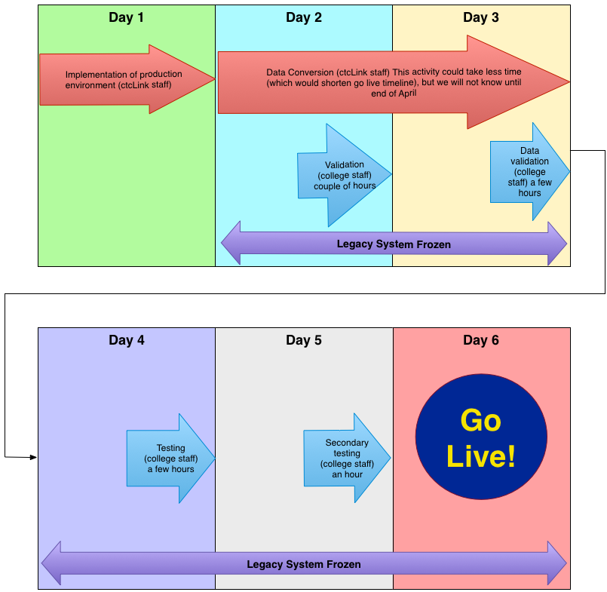
Go Live…
Notes:
Go live date will be adjusted
Go live activity period approximately a week long
Legacy system will be frozen once final conversion begins
Establishing “war room” for this period with open communication lines to ctcLink team

Slide 10
Questions?

