Slide 1
FirstLink Update for ITC
December 12, 2014

Slide 2
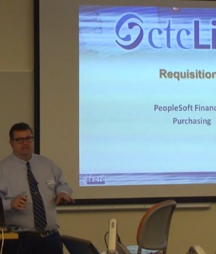
Training
December started major round of training
Campus Solutions, Finance and Human Capital Management training facilitated by vendor and ctcLink trainers
Over 200 hours of training in December
Additional training scheduled for January and February

Slide 3
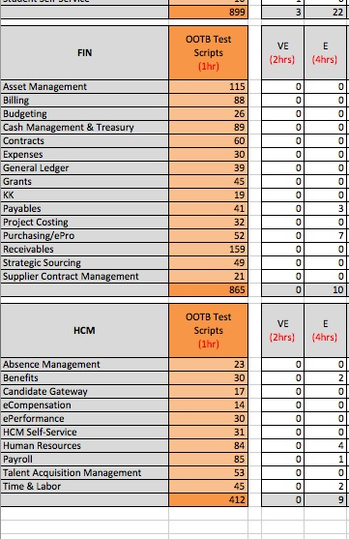
  User Acceptance Testing
80% complete with PeopleSoft core
CEMLI testing is now underway
“Day In the Life” testing to correspond with training
Working through accessibility testing

Slide 4
ODS and Supporting Systems
Spokane has completed their ODS. It includes all of the tables and data in the Data Mapping document Ver 1.1 found on the ctcLink Office365 site
Tacoma ODS is set up and staff are about a third of the way through the supporting systems

Slide 5

Security
Security Role Matrix - A good place to start is looking at existing positions and how they will fit in new system
Security Strategy - Spokane is using a de-centralized approach while Tacoma is using a centralized approach

Slide 6
Reporting
Delivered reports are now being tested in UAT. This testing produces the actual report output and these are being hosted in the ctcLink Office365 site. It is a good idea to start exploring these reports now.

Slide 7
Gateway and Activate your Account
URL is gateway.ctclink.us. Colleges may want to set up own URL and redirect. Spokane is using ctclink.spokane.edu
Activate Your Account currently under development. End users will need to know First Name, Last Name, Date of Birth, SID/EMPLID to use

Slide 8
Countdown Document
ctcLink Project Team is working on countdown document with a list of tasks that need to be completed before, during and after go live.

Slide 9
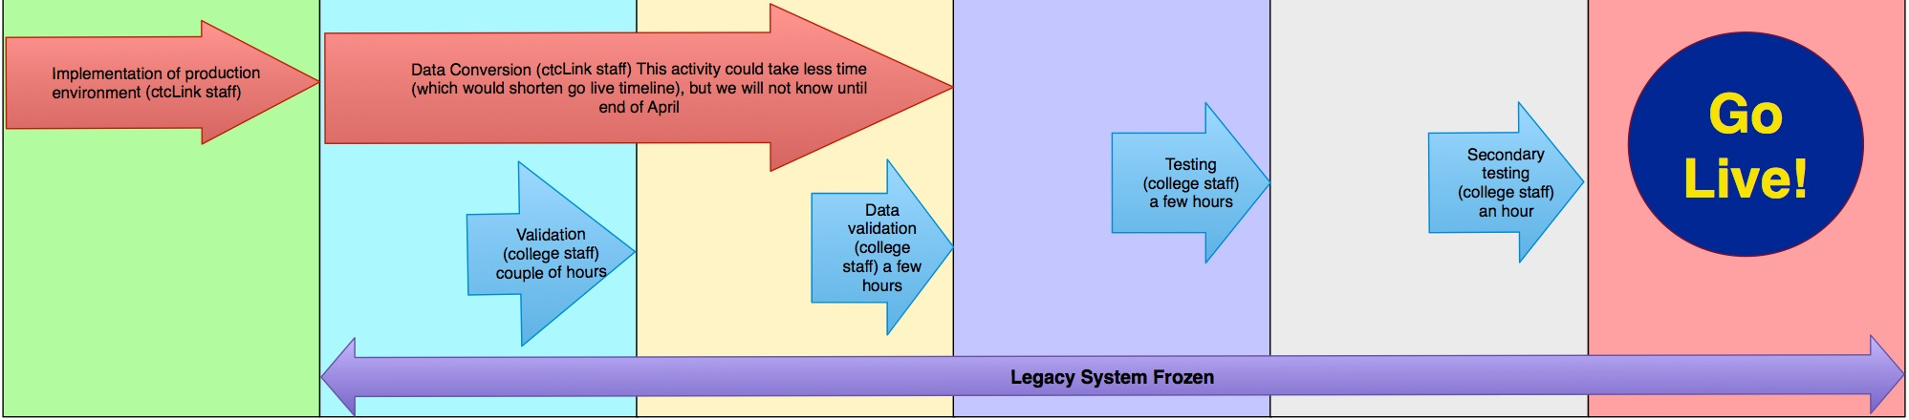
Go Live…2 Months!
Notes:
Go live activity period approximately a week long
Legacy system will be frozen once final conversion begins
Establishing “war room” for this period with open communication lines to ctcLink team

Slide 10
Questions?
email aduckworth@tacomacc.edu or
Dick.Hol@ccs.spokane.edu

