Slide 1
TCC ctcLink Update
ITC February 10th, 2014

Slide 2
Data Validation Cycle 3
Notes:
Campus Solutions
All colors through purple are being validated this round
Experiencing some issues with course data should be fixed soon

Slide 3
Data Validation Cycle 3
Notes:
HCM
All colors through purple being validated

Slide 4
Data Validation Cycle 3
Notes:
Finance
All colors through purple being validated

Slide 5
Badges
Notes:
Badges
Working on badge matrix for aligning training outcomes
Above is example from badge mock up created by TCC graphics person
Will have an issuing process created before FirstLink training launch

Slide 6
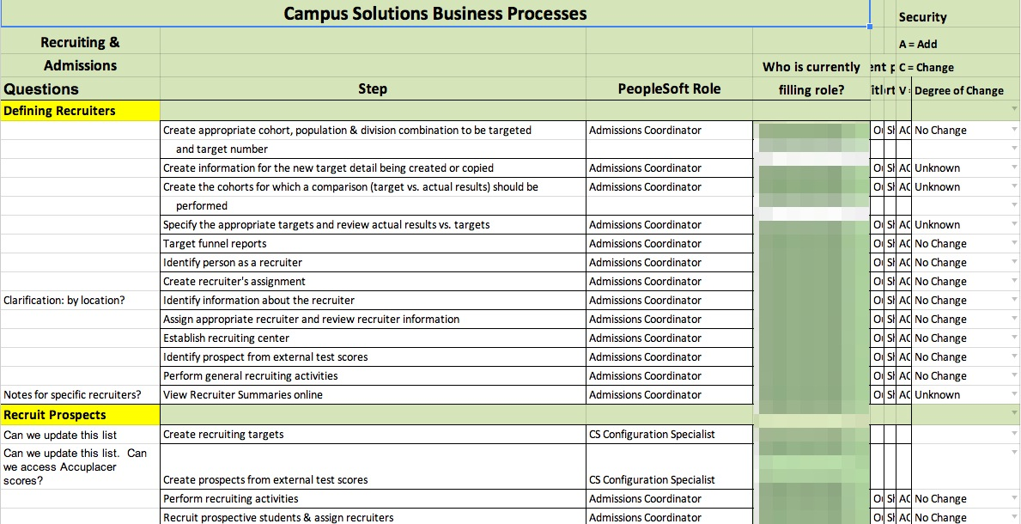
Business Process Diagram Analysis
Notes:
BPD Analysis
Completed Campus Solutions
Analyzed PeopleSoft business processes to determine level of change
Very high-level analysis. Captured questions for clarification from State team

