Slide 1
ctcLink and Student Services

Slide 2
Timeline
Configuration
Development
Conversion
Training
Testing
Cutover

Slide 3
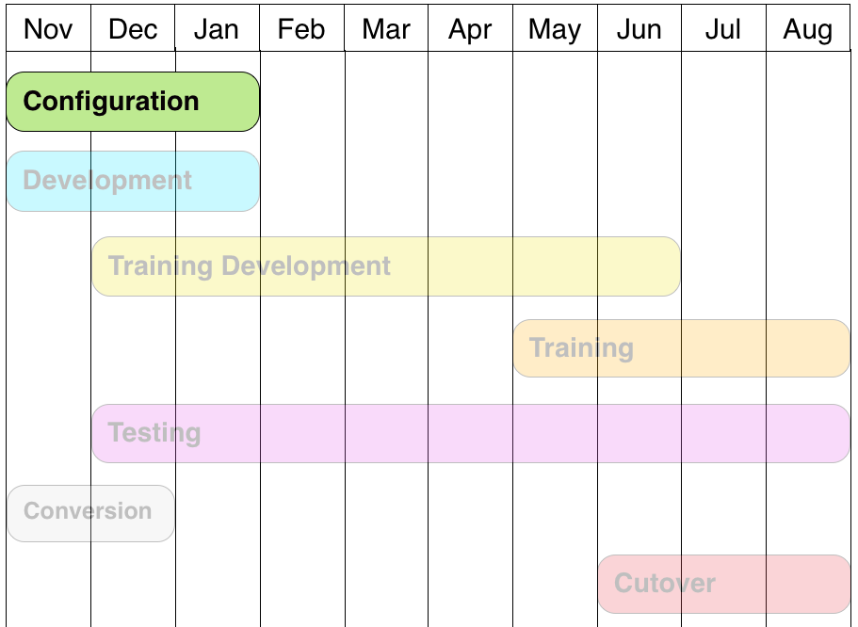
Configuration

Slide 4
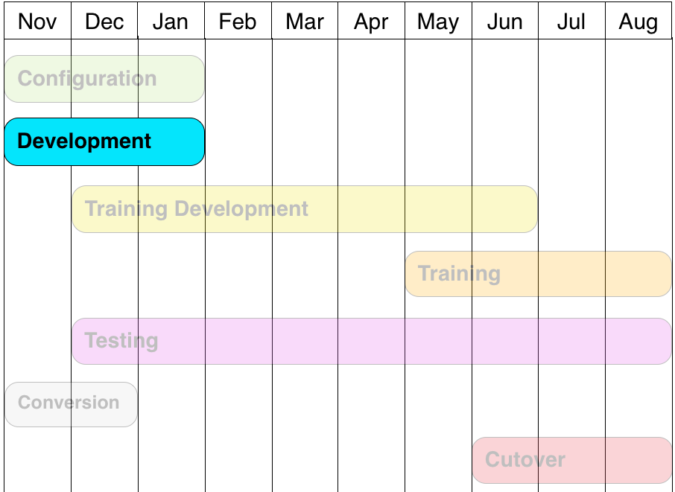
Development

Slide 5
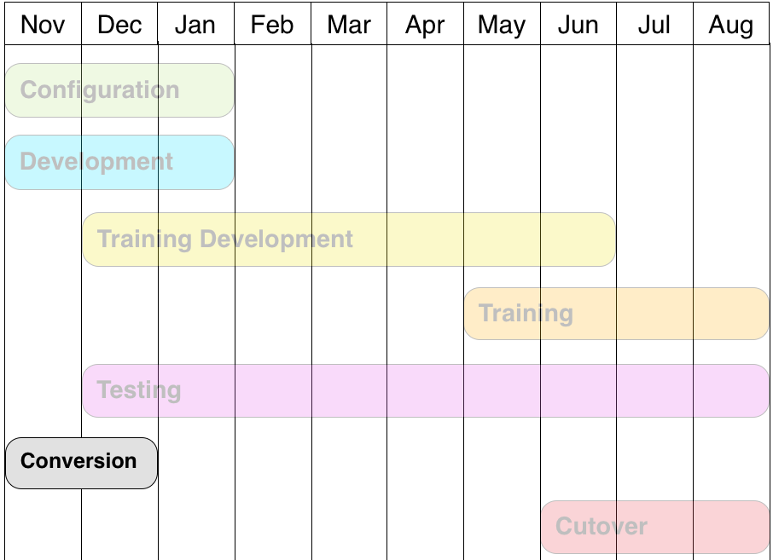
Conversion

Slide 6
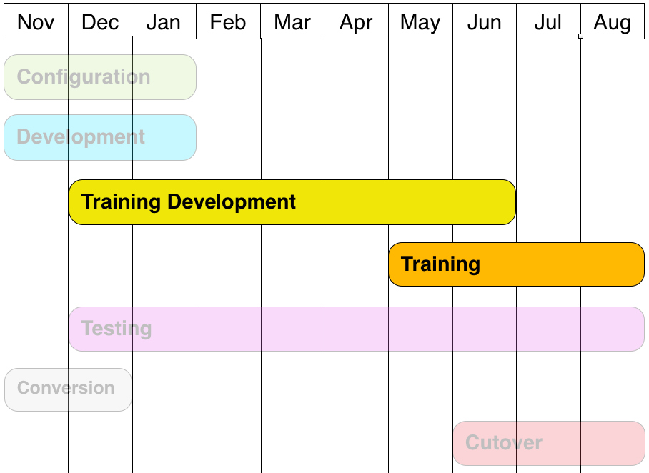
Training

Slide 7
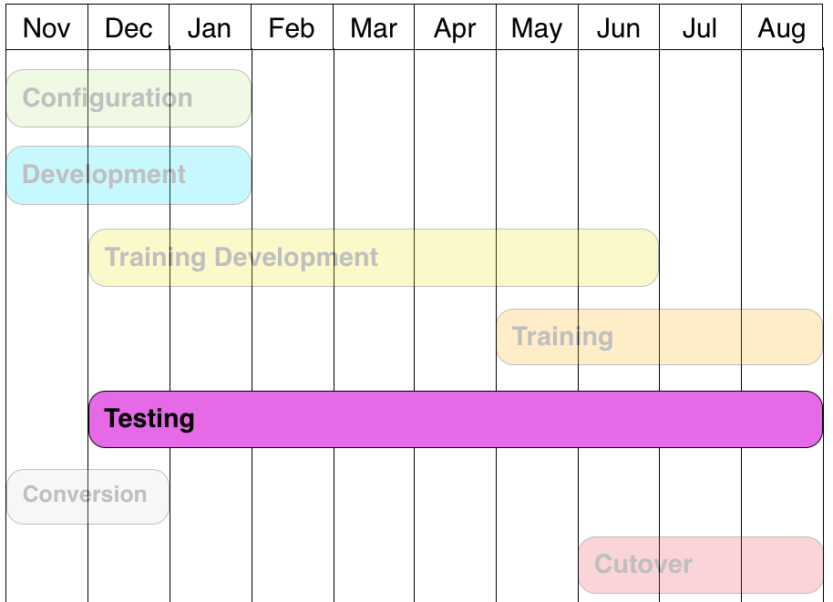
Testing

Slide 8
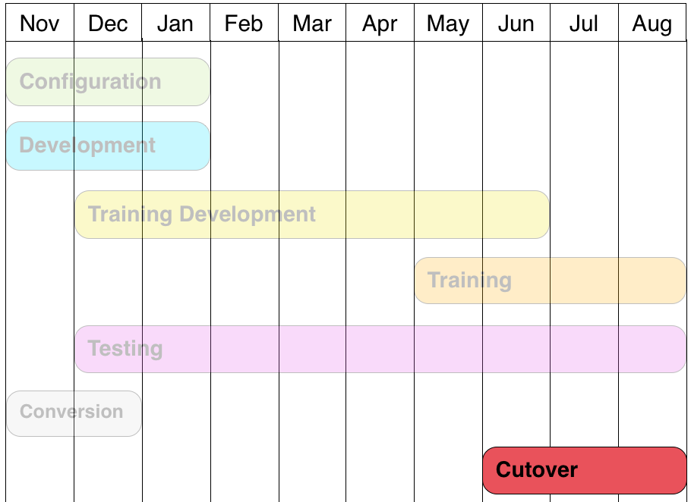
Cutover

Slide 9
Working Differently
EMPL ID
Used for all students and employees.
Travels with student/employee to any state community college.

Slide 10
Working Differently
Course vs Class
ENGL 101 is a course
Item number 2341, section C is a class
Why is this important?

Slide 11
Working Differently
Effective Dates
Tracks all changes and when they are made
Allows tracking for students, courses and other items.

Slide 12
Working Differently
Matriculation
Process of moving student from admissions to records
Student not active until this occurs

Slide 13
Working Differently
Student Application
Create applications for different student types
i.e. Running Start, International

Slide 14
Working Differently
Degree Audit
Must be built from scratch
Has a better hierarchy for placing classes toward a degree

Slide 15
Working Differently
Roles
Replaces screen permissions
Based on position descriptions

Slide 16
Reporting
In process of identifying reports to be recreated
Two types
Compliance
Operational
Priority to recreate the most critical

Slide 17
Expectations
The goal of the project is to standardize business processes across the colleges with the least amount of customization and college-unique configuration as possible.
Customization will be considered only as mandated by a statutory requirement or a business case that benefits the system as a whole.

Slide 18
Expectations
Mobile apps: many of the new online services will be available to students, faculty and staff from their smart phone, tablet or other mobile device.
Students, faculty and staff will have online, self-service access to manage their personal information and do much of their college business online.

Slide 19
Expectations
Online Payment of tuition and fees.
Online academic advising gives students and advisors real-time access to academic records and reports, including a built-in degree audit function.
A single electronic record for each student, with one student ID number available to all colleges (the same applies for employee IDs).

Slide 20
Expectations
A single admission application process regardless of which college or which quarter a student decides to attend.
A single financial aid application process.
A degree audit system shared by all colleges.
Self-service features for students, faculty and staff.

Slide 21
Expectations
A financial aid system that is integrated into the student management system.
A centralized catalog of courses at all 34 colleges.
Common source for campus data with features to coordinate all types of campus communication.

Slide 22
Expectations
Ability to manage student services and student administration online in one place, in real time (while protecting sensitive data).
Tools to track incoming and outgoing communication - from prospective students to alumni.
Full-featured financial aid applicant processing with automated student notifications.
Manage and analyze all aspects of enrollment, catalog and class schedule maintenance, prerequisites, wait lists, class start/end dates, transfer credits, transcripts and more.

Slide 23
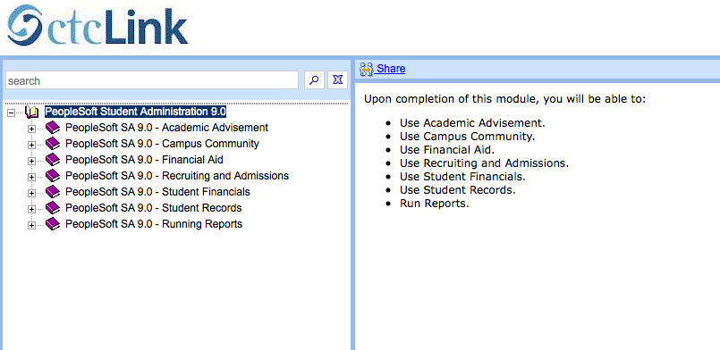
User Productivity Kit (UPK)

Slide 24
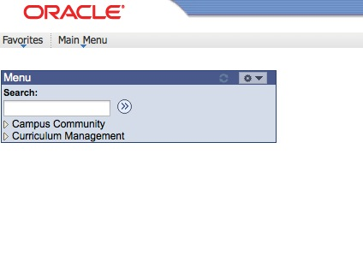
Data Validation
Process of ensuring Legacy data is correct in PeopleSoft system

Slide 25
Training
Types
Badges

Slide 26
Types

Slide 27
Badges
Photo courtesy photojennic
Photo courtesy dbstyles

