Slide 1
ctcLink Update and Demo
Classified Staff Breakaway 2014

Slide 2
Thank You!
Notes:
Ask SMEs to stand up and give them a hand

Slide 3
Who we are and why we do it
Notes:
Attended TCC for AAS degree
Work Study in Library
Graduated early 90s
Came back to work part-time late 90s
Sense of community, the people and students brought me back
Recruited by Tess Hartwell to be distance learning assistant in 2000

Slide 4
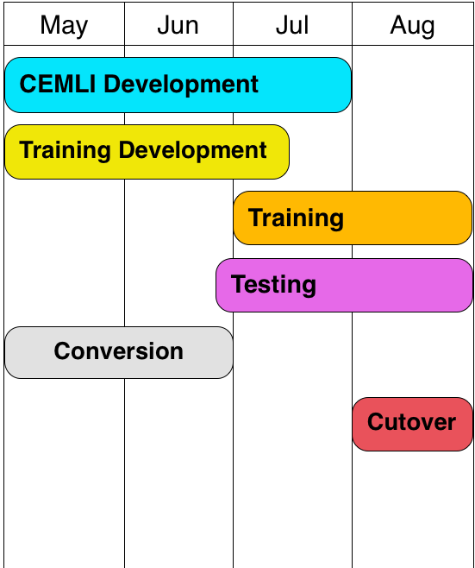
Timeline

Slide 5
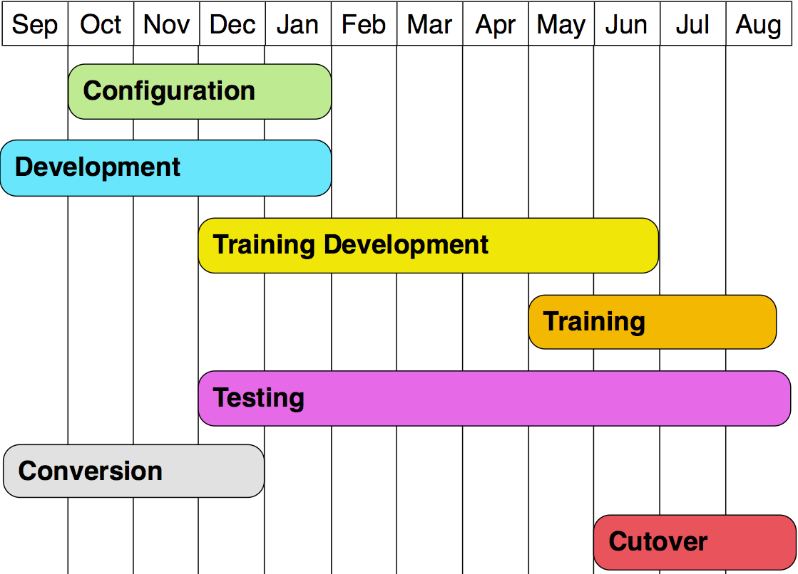
Timeline

Slide 6
Timeline

Slide 7
Demo

Slide 8
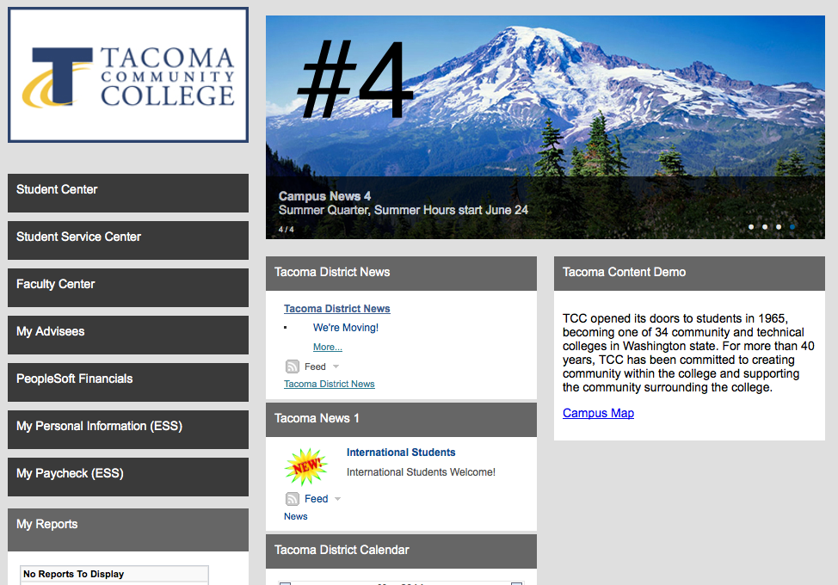
The Gateway
Notes:
Live

Slide 9
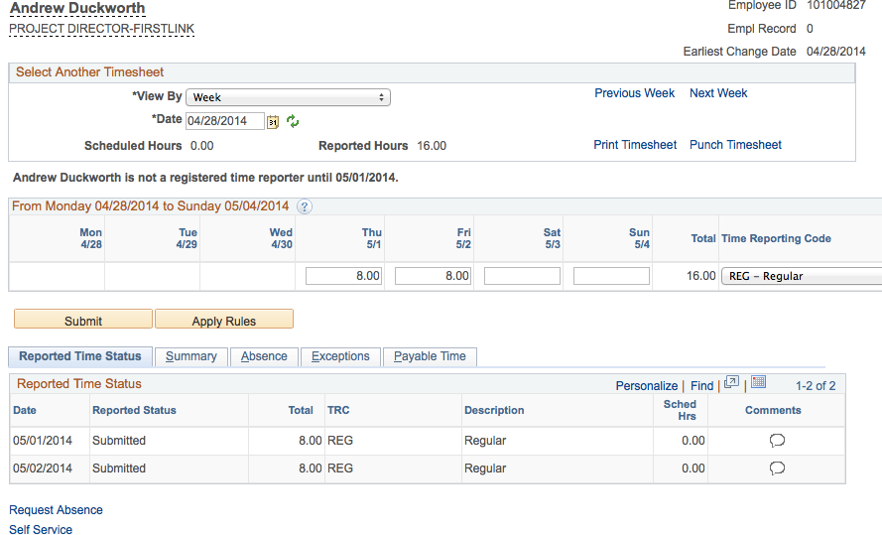
Timesheet
Notes:
Live

Slide 10
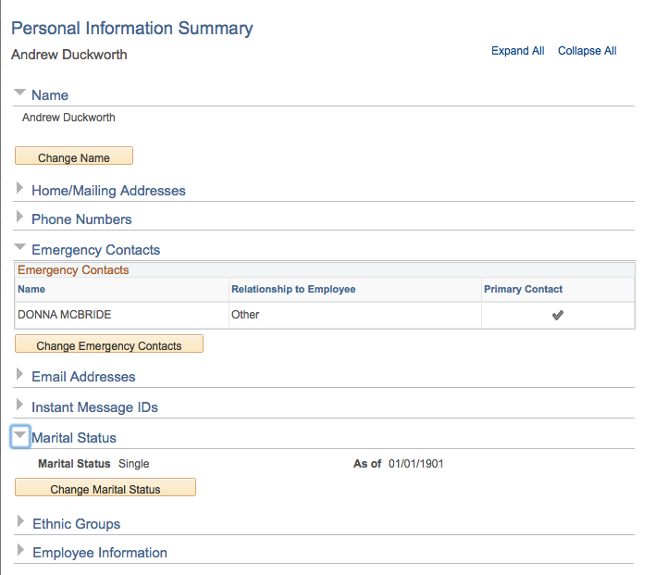
Personal Information
Notes:
Live

Slide 11
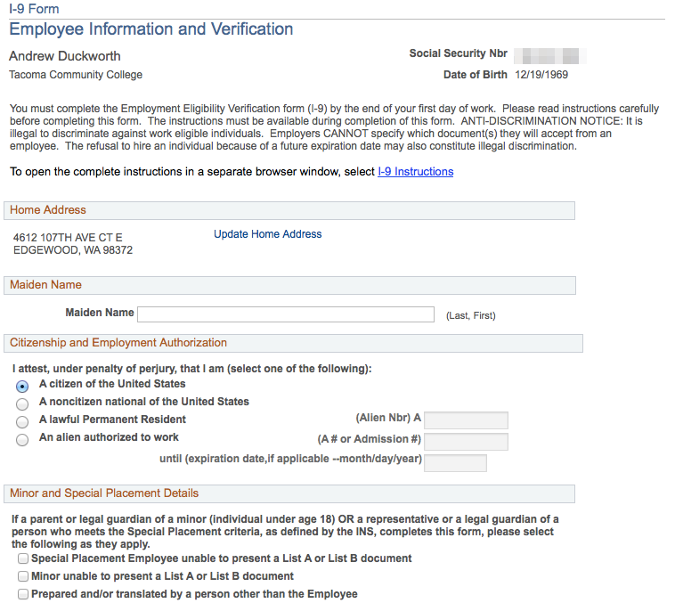
I-9 Form
Notes:
Slide

Slide 12
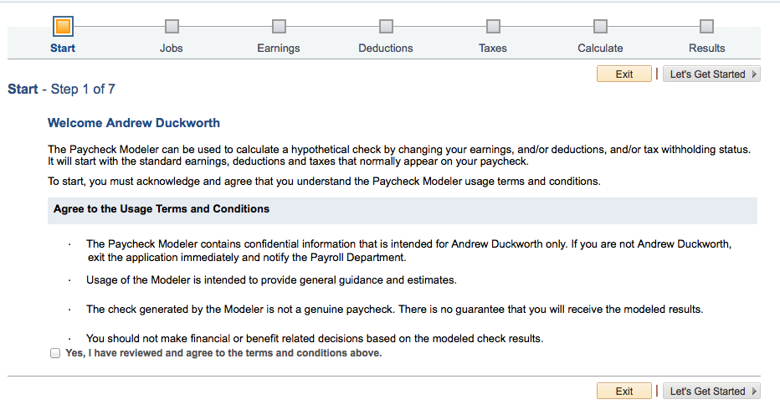
Paycheck Modeler
Notes:
Live

Slide 13
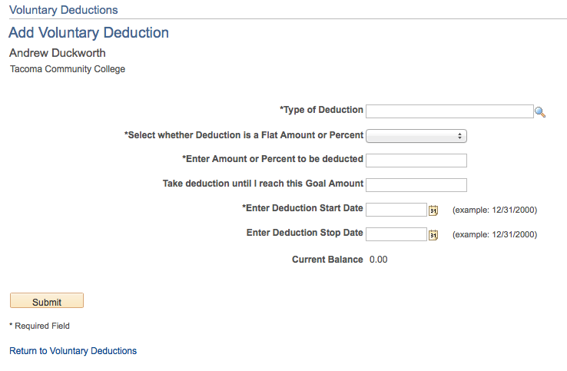
Voluntary Deductions
Notes:
Live

Slide 14
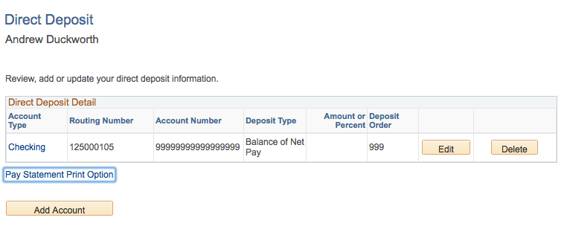
Direct Deposit
Notes:
Live

Slide 15
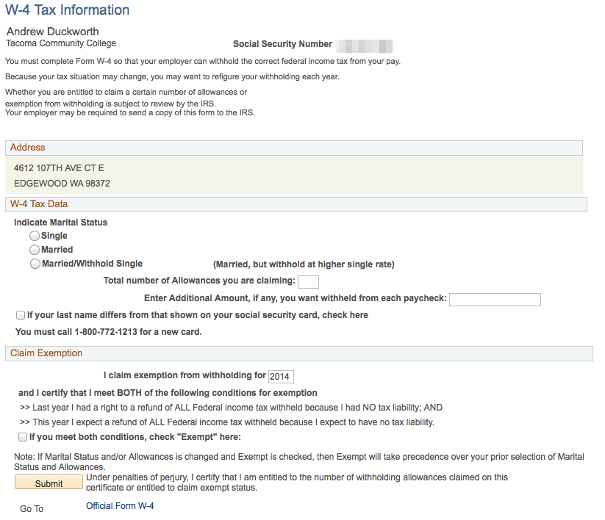
W-4 Tax Information
Notes:
Slide

Slide 16
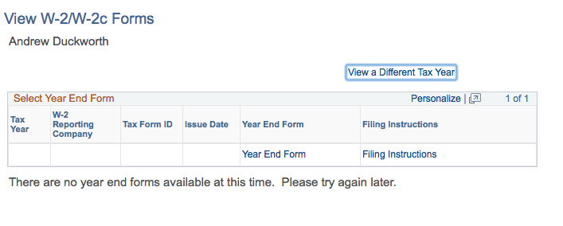
W-2 Forms
Notes:
Live

Slide 17
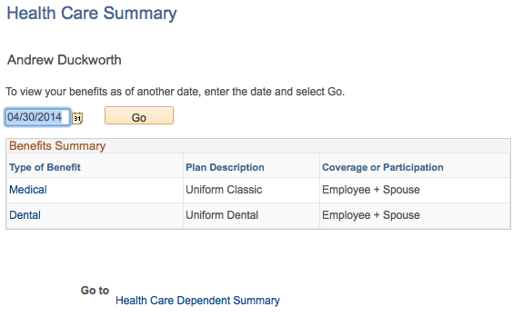
Health Care Summary
Notes:
Live

Slide 18
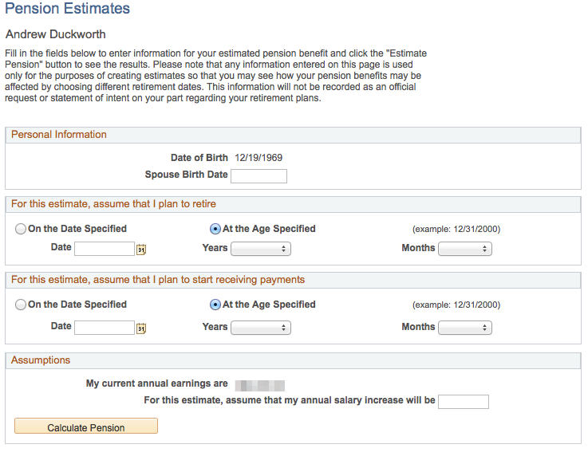
Pension Estimates
Notes:
Slide

Slide 19
Questions

